Slide 1
\LaTeX
For Scientific Documentation
By Ammar Taha Mohamedy
Lists

Slide 2
List Types
Numbered List: enumerate.
Unnumbered List: itemize.
Description List: description.
To Create an Item: \item Command.

Slide 3
Numbered Lists
\begin{enumerate}
\item ……..
\item ……..
.
.
.
.
\end{enumerate}
Default Numbering: Arabic Numbers.

Slide 4
Unnumbered Lists
\begin{itemize}
\item ……..
\item ……..
.
.
.
.
\end{itemize}
Default Marking: Bullets.

Slide 5
Description Lists
\begin{description}
\item[Label] ……..
\item[Label] ……..
.
.
.
.
\end{description}

Slide 6
User-defined Lists
\begin{list}
{Label Commands}
{Formatting Commands}
\item
\item
\end{list}
\newenvironment
{envName}
{env. Start Routine}
{env. End}

Slide 7
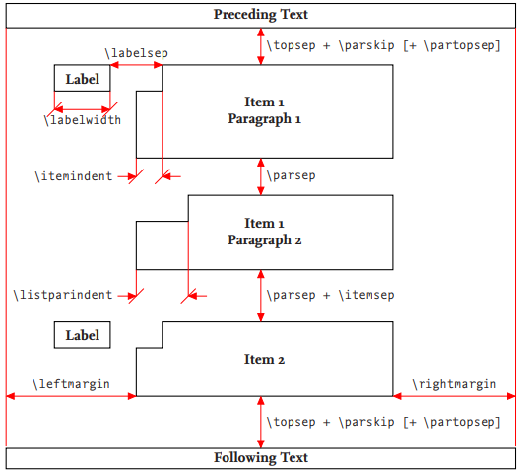
Figure 3.6 from LaTeX and Friends, M.R.C. van Dongen, Springer 2017.

Slide 8
Thanks for Watching !!

